Slide 1
CAPSTONE PROJECT
Presentation For EOMP#2
App quản lý Công ty BĐS
Team 3: Hello World
Mentor: Đặng Đình Hòa

Slide 2
01
Team Introduction
Agenda
02
Project Plan
03
Architectural
04
Requirement
05
Monitoring & control

Slide 3
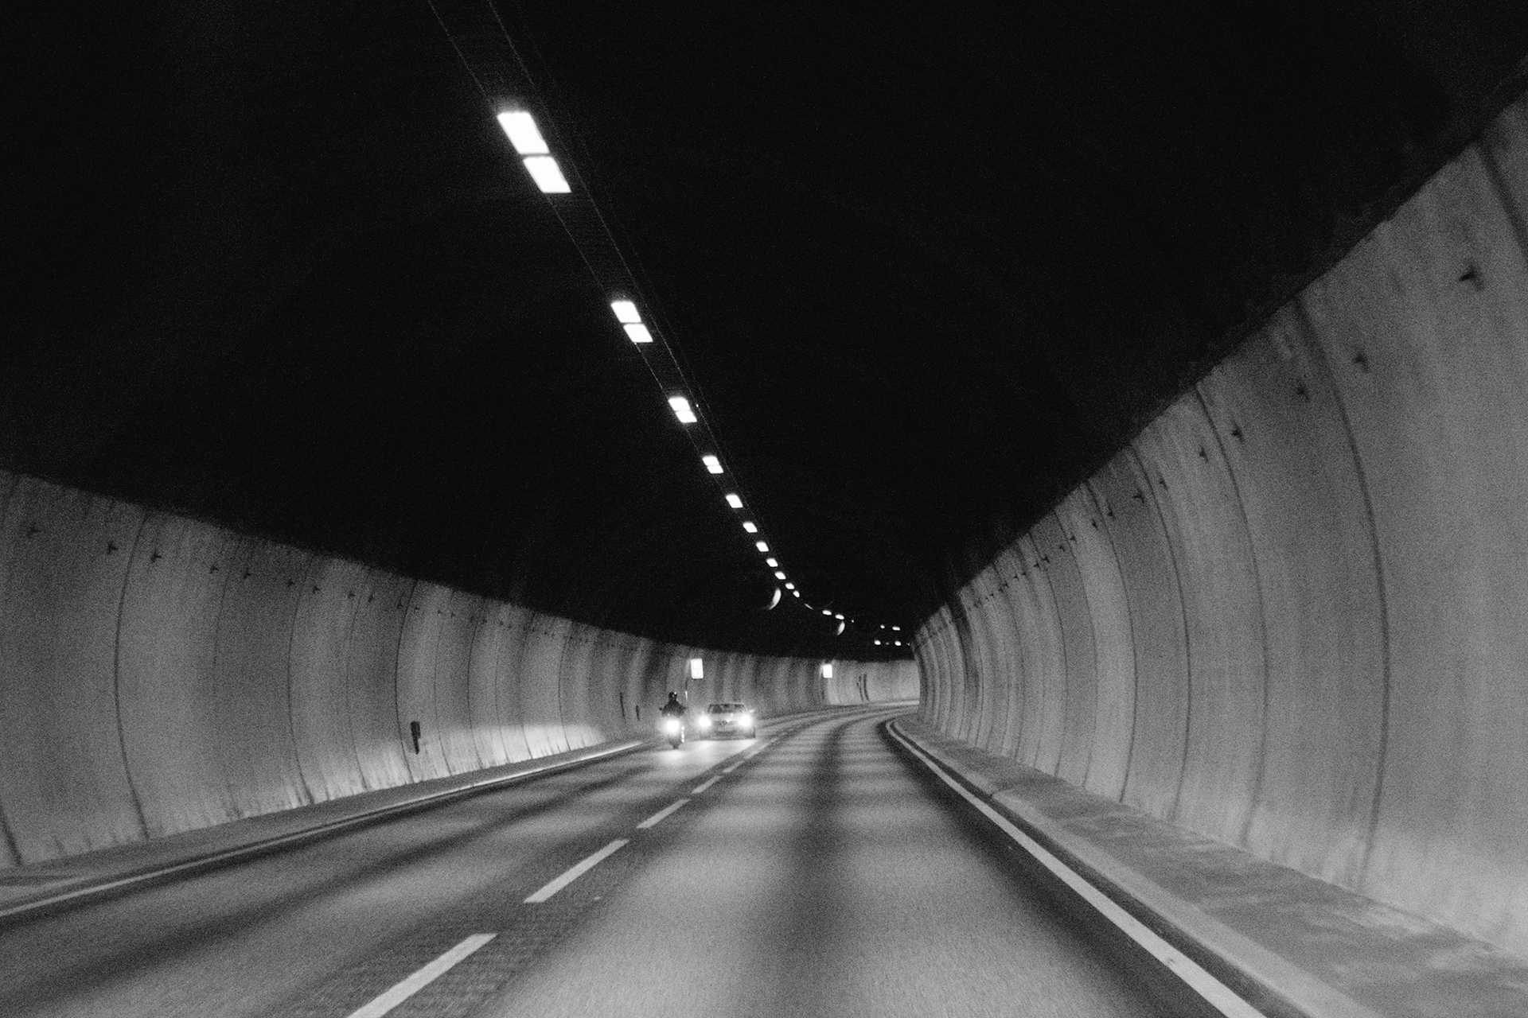

1. TEAM INTRODUCTION
LOGO TEAM
STAKEHOLDERS
Name | Role
Mr. Châu | Customer
Mr. Nhật | Technical assistance

Slide 4

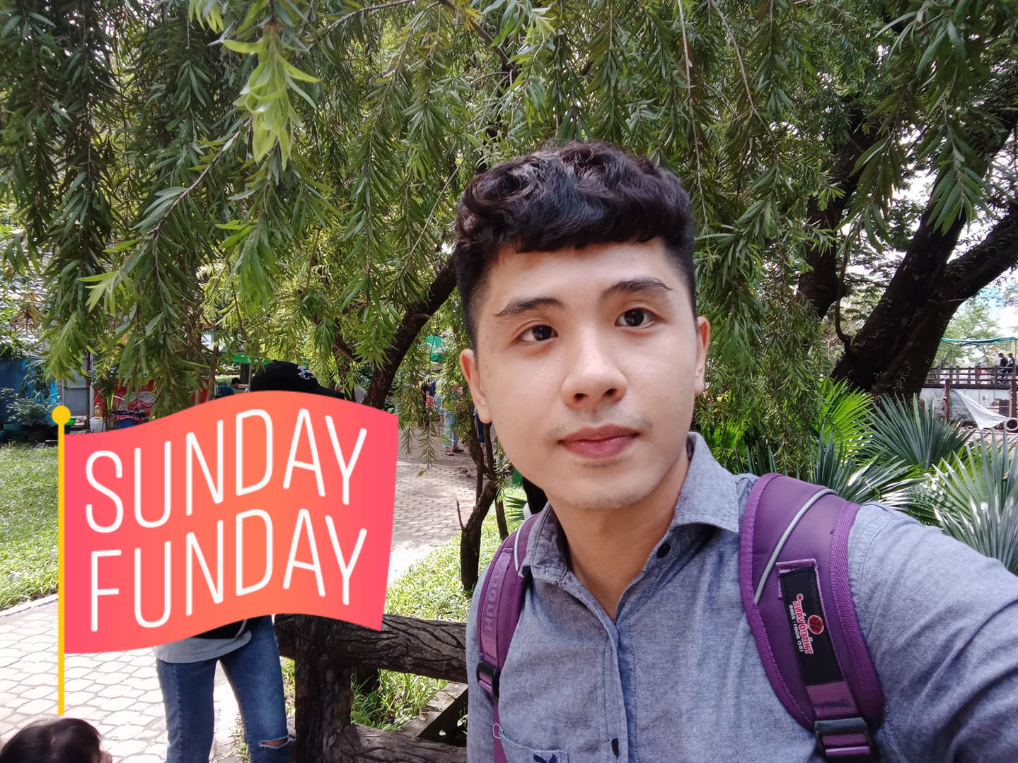


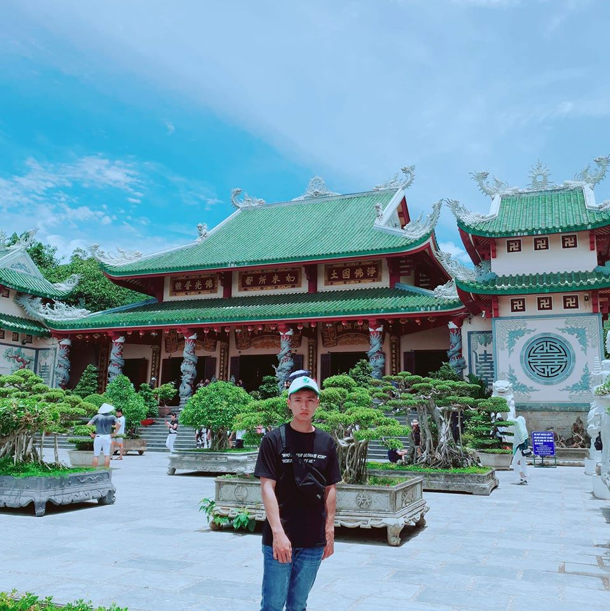
Team member
Huỳnh Tuấn Đạt
Trương Quang Vương
Trịnh Như Phương
Phạm Quốc Nhân
Nguyễn Anh Minh
Leader
Member
Member
Member
Member

Slide 5

Communication Team

Slide 6
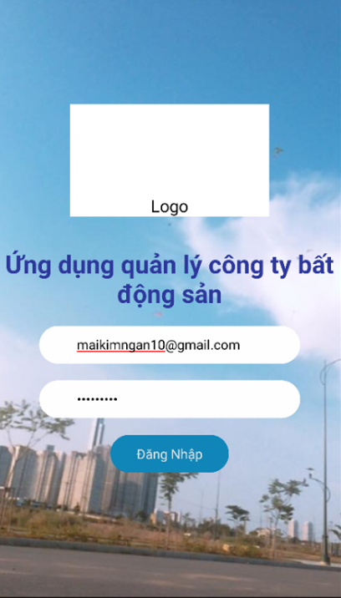
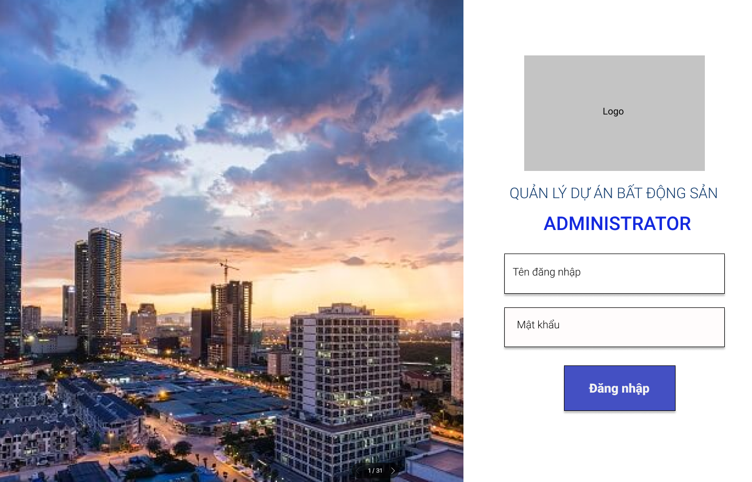
2. PROJECT PLAN
Project Overview
Website: Managing employees and projects. Mobile: Display project information, statistics, reports, project information, register for leave

Slide 7
2.1 PROJECT PLAN
Communication management
Meetings
 | Monday | Tuesday | Wednesday | Thursday | Friday | Saturday | Sunday
Morning | 9:00 AM Team meeting |  |  | 9:00 AM Team meeting
Afternoon |  | 3:30 PM Mentor meeting |  |  |  | 1:00 PM Mentor meeting

Slide 8
2. PROJECT PLAN
Configuration management
Configuration Items
No. | Category | CIs | Item List
1 | Document | Requirement | Name rule, font, size, color,content. Revision. In progress version (Ex: ver1.1, ver1.2 …) Base line version (Ex:ver1.0,2.0,3.0…).
 |  | Architecture and Design
 |  | Implementation
 |  | Testing
 |  | Project Management
2 | Drawing | Use case | Symbols for drawing
 |  | Class Diagram
 |  | Sequence Diagram
 |  | Context Diagram
3 | Tool | Develop | Visual Studio Code, Android Studio
 |  | Draw | Draw.io
 |  | Create Document | Microsoft Word, Excel
 |  | Management | Trello, Excel

Slide 9

2. PROJECT PLAN
Configuration management
2. Document name
No. | Process Name | Process code
1 | Project Management | PM
2 | Requirement | RE
3 | Architecture | AR
4 | Detail Design | DD
5 | Implementation | IM
6 | Testing | TE
<Name of document> = <Code>_<Name>_<X.X>
“Code” is name code of document
“Name” is the name of document
“X.X” is version of documentation: v0.1, v0.2…
Ex: Name of configuration management plan document of project:
PM_ConfigurationManagerment_Ver1.0

Slide 10


2. PROJECT PLAN
Training Plan
Content | Description
Training Content | React Native, GIS
Training Time | Weekly (Tuesday, Thursday, Saturday: 08:00->12:00)
Location | Coffee O’Clock, Class Room VLU
Participants | Huỳnh Tuấn Đạt Trịnh Như Phương Nguyễn Anh Minh Trương Quang Vương Phạm Quốc Nhân

Slide 11
2. PROJECT PLAN
Training Report
Day 1: 25/11/2019
Member
Name | Participation(Y/N)
Dat Huynh | Y
Minh Nguyen | Y
Phuong Trinh | Y
Nhan Pham | Y
Vuong Truong | Y
Training Topic | Time | Status | Note
Install with React Native Development | 08:00 – 10:00 | Complete | EvidenceReport/EvidenceReport-Day01.docx
Install the android virtual machine | 10:00 – 12:00 | Complete

Slide 12
2. PROJECT PLAN
Risk Management
 | Impact
Probability | Negligible (1) | Minor (3) | Moderate (5) | Serious (8) | Critical (10)
Very likely to occur (5) | 5 | 15 | 25 | 40 | 50
Probably will occur (4) | 4 | 12 | 20 | 32 | 40
About 50% chance of occuring (3) | 3 | 9 | 15 | 24 | 30
Unlikely (2) | 2 | 6 | 10 | 16 | 20
Very unlikely to occur (1) | 1 | 3 | 5 | 8 | 10

Slide 13
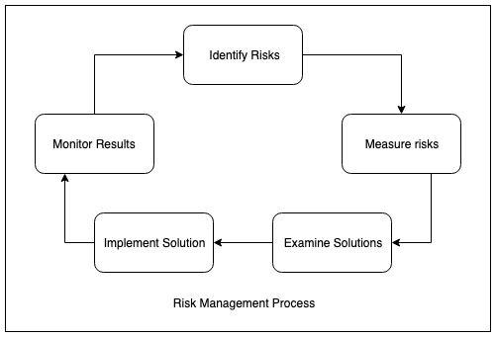
2. PROJECT PLAN
Risk Management

Slide 14
2. PROJECT PLAN
Risk List
Number | Risk name | Possibility | Impact | Priority | How to prevent or minimize
1 | Difficulties with new technologies | Moderate | Moderate | Moderate | 1. Organize training sessions on new technologies for all members
2 | Lost data | High | High | High | 1. Online storage 2. Create a backup file
3 | Machinery and equipment had problems during the project's implementation | Moderate | Moderate | Moderate | 1.Implementation on many devices
4 | Performance is not guaranteed | High | High | High | 1. Keep members in the best state 2. Regularly interested and updated the working situation of the members.
5 | Customer change | High | Moderate | Moderate | 1. Having a contract, a written signature of the customer for specific requirements upon project receipt. 2. There is a specific process for customer change
6 | Member left the project | High | High | High | 1. Ensure all members are fully involved in the work of the project. 2. Regular meetings (outside work) to build solidarity 3. Having a mechanism to manage and archive work documents of all members.
7 | Members have unequal qualifications | High | High | High | 1. Training members from the beginning of the project. 2. Organize cross-training sessions for members.

Slide 15
2. PROJECT PLAN
Product Backlog
ID | FEATURE | FUNCTION | PRIORITY | PLATFORM | START | FINISH | ASIGN TO | STATUS
FR.01 | Đăng nhập | Đăng nhập/ Đăng xuất | High | Mobile App | 12/23/2019 | 12/24/2019 |  | In Progress
FR.02 |  | Đăng nhập/ Đăng xuất | High | Web App | 12/23/2019 | 12/24/2019 |  | In Progress

Slide 16
2. PROJECT PLAN
Product Backlog
ID | FEATURE | FUNCTION | PRIORITY | PLATFORM | START | FINISH | ASIGN TO | STATUS
FR.03 | Quản lý thông tin | Tìm kiếm nhân sự | Medium | Mobile App | 12/23/2019 | 12/24/2019 |  | In Progress
FR.04 |  | Xem danh sách nhân sự | Medium | Mobile App | 12/23/2019 | 12/24/2019 |  | In Progress
FR.05 |  | Tải lên sơ đồ tổ chức | Medium | Web App | 12/25/2019 | 12/26/2019 |  | Not Started
FR.06 |  | Xem sơ đồ tổ chức | Medium | Mobile App | 12/25/2019 | 12/26/2019 |  | Not Started
FR.07 |  | Thêm chính sách công ty | Medium | Web App | 12/25/2019 | 12/26/2019 |  | Not Started
FR.08 |  | Sửa chính sách công ty | Medium | Web App | 12/26/2019 | 12/27/2019 |  | Not Started
FR.09 |  | Xóa chính sách công ty | Medium | Web App | 12/27/2019 | 12/28/2019 |  | Not Started
FR.10 |  | Xem chính sách công ty | Medium | Mobile App | 12/25/2019 | 12/26/2019 |  | Not Started
FR.11 |  | Xem danh sách chính sách công ty | Medium | Web App
FR.12 |  | Xem danh sách nhân sự | Medium | Web App
FR.13 |  | Xem danh sách sơ đồ tổ chức | Medium | Web App | 12/25/2019 | 12/26/2019 |  | Not Started

Slide 17
2. PROJECT PLAN
Product Backlog
ID | FEATURE | FUNCTION | PRIORITY | PLATFORM | START | FINISH | ASIGN TO | STATUS
FR.14 | Quản lý tài khoản | Xem thông tin tài khoản | Medium | Web App | 12/23/2019 | 12/24/2019 |  | Not Started
FR.15 |  | Thêm tài khoản | High | Web App | 12/27/2019 | 12/28/2019 |  | Not Started
FR.16 |  | Ẩn tài khoản | High | Web App | 12/27/2019 | 12/28/2019 |  | Not Started
FR.17 |  | Sửa tài khoản | High | Web App | 12/27/2019 | 12/28/2019 |  | Not Started
FR.18 |  | Phân quyền | High | Web App | 12/27/2019 | 12/28/2019 |  | Not Started
FR.16 | Quản lý dự án bất động sản | Xem danh sách dự án bất động sản | High | Mobile App | 1/6/2020 | 1/8/2020 |  | Not Started
FR.17 |  | Tìm kiếm dự án bất động sản | Medium | Mobile App | 1/6/2020 | 1/8/2020 |  | Not Started
FR.18 |  | Xem chi tiết dự án | High | Mobile App | 1/6/2020 | 1/8/2020 |  | Not Started
FR.19 |  | Thêm dự án bất động sản | High | Web App | 1/6/2020 | 1/8/2020 |  | Not Started
FR.20 |  | Sửa dự án bất động sản | Medium | Web App | 1/6/2020 | 1/8/2020 |  | Not Started

Slide 18
2. PROJECT PLAN
Product Backlog
ID | FEATURE | FUNCTION | PRIORITY | PLATFORM | START | FINISH | ASIGN TO | STATUS
FR.21 | Quản lý thống kê, báo cáo | Xem kết quả kinh doanh | High | Mobile App | 1/9/2020 | 1/11/2020 |  | Not Started
FR.22 |  | Tải lên kết quả kinh doanh | High | Web App | 1/9/2020 | 1/11/2020 |  | Not Started
FR.23 |  | Lọc kết quả kinh doanh | High | Mobile App | 1/9/2020 | 1/11/2020 |  | Not Started
FR.24 |  | Xem so sánh kết quả kinh doanh | High | Mobile App | 1/9/2020 | 1/11/2020 |  | Not Started
FR.25 |  | Xem đồ thị kết quả kinh doanh | High | Mobile App | 1/9/2020 | 1/11/2020 |  | Not Started
FR.26 | Quản lý công tác | Đăng ký chuyến đi công tác | High | Mobile App | 2/10/2020 | 2/11/2020 |  | Not Started
FR.27 |  | Duyệt chuyến đi công tác | High | Mobile App | 2/10/2020 | 2/11/2020 |  | Not Started
FR.28 |  | Hủy chuyến đi công tác | High | Mobile App | 2/10/2020 | 2/11/2020 |  | Not Started
FR.29 |  | Định vị vị trí chuyến công tác | High | Mobile App | 2/10/2020 | 2/11/2020 |  | Not Started
FR.30 |  | Xem lịch sử chuyển đi công tác | High | Mobile App | 2/10/2020 | 2/11/2020 |  | Not Started
FR.31 |  | Tìm kiếm chuyến đi công tác | High | Mobile App | 2/13/2020 | 2/15/2020 |  | Not Started

Slide 19
2. PROJECT PLAN
Product Backlog
ID | FEATURE | FUNCTION | PRIORITY | PLATFORM | START | FINISH | ASIGN TO | STATUS
FR.32 | Quản lý nghỉ việc | Đăng ký nghỉ việc | Medium | Mobile App | 2/13/2020 | 2/15/2020 |  | Not Started
FR.33 |  | Xem lịch sử nghỉ việc | Medium | Mobile App | 2/13/2020 | 2/15/2020 |  | Not Started
FR.34 |  | Phê duyệt nghỉ việc | Medium | Mobile App | 2/13/2020 | 2/15/2020 |  | Not Started
FR.35 |  | Tìm kiếm đơn xin nghỉ việc | Medium | Mobile App | 2/13/2020 | 2/15/2020 |  | Not Started
FR.36 | Chức năng sinh nhật | Chúc mừng sinh nhật | Low | Mobile App | 2/13/2020 | 2/15/2020 |  | Not Started

Slide 20
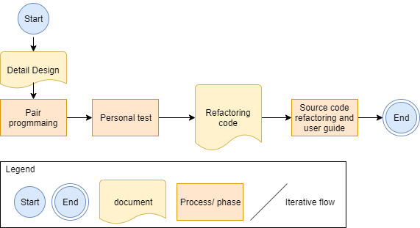
2. PROJECT PLAN
Implement Process

Slide 21
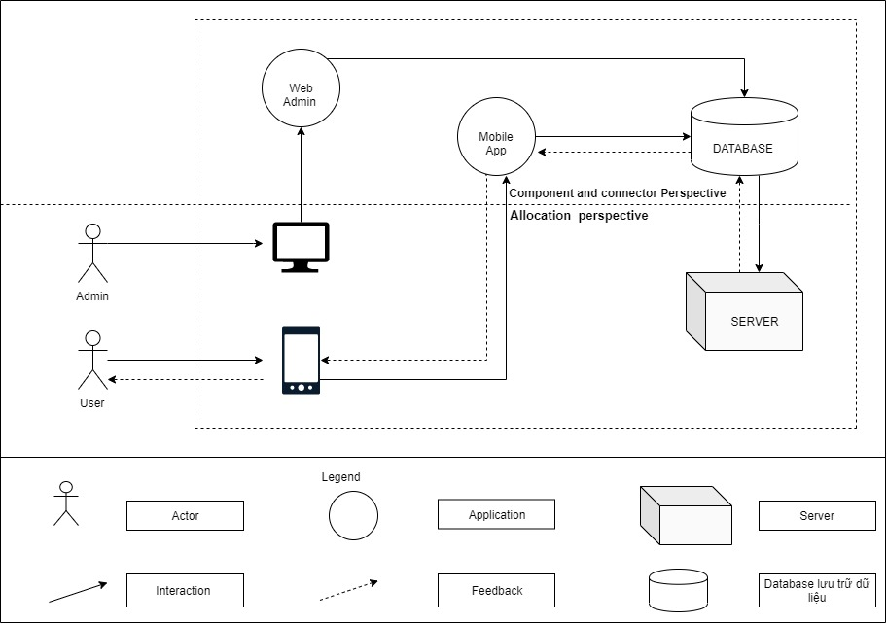
3. ARCHITECTURAL
Context Diagram

Slide 22
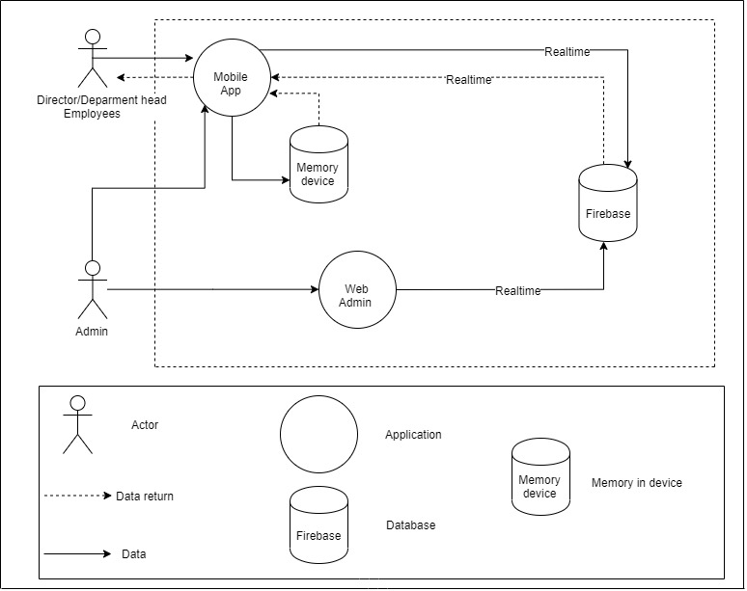
3. ARCHITECTURAL
Performance

Slide 23
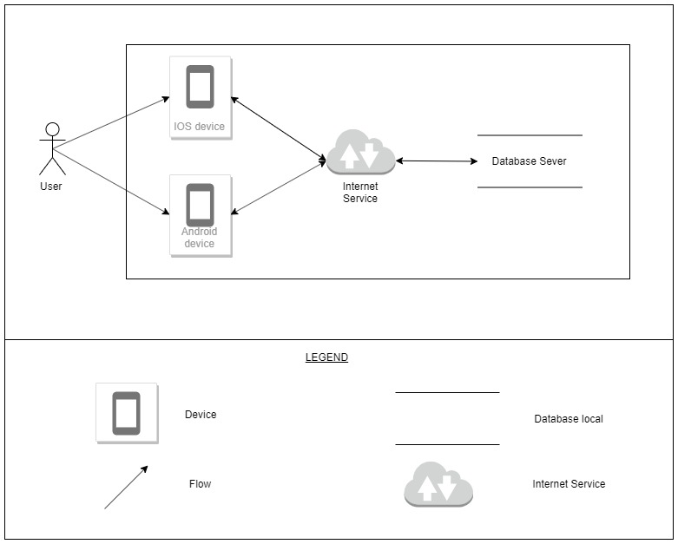
3. ARCHITECTURAL
Portability (Physical)

Slide 24
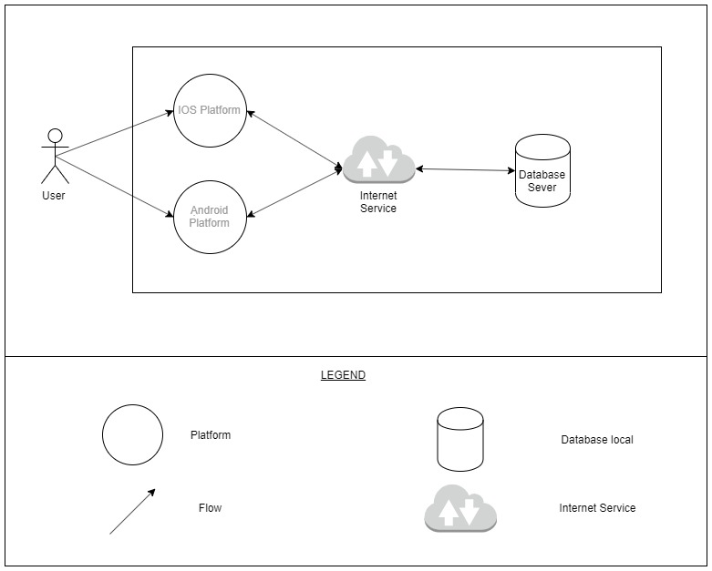
3. ARCHITECTURAL
Portability (Dynamic)

Slide 25
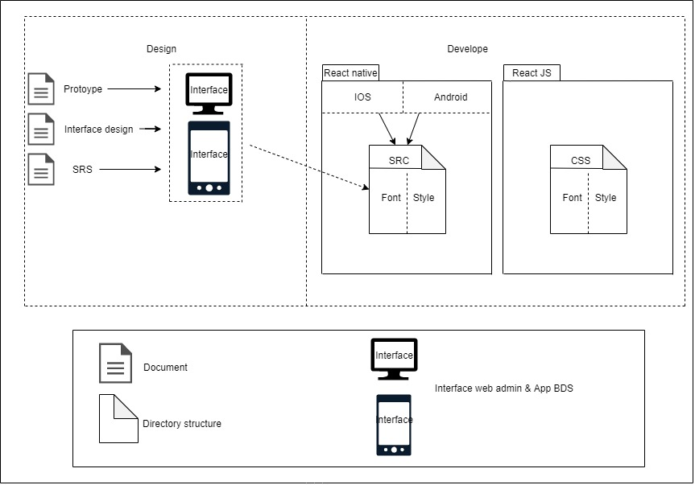
3. ARCHITECTURAL
Usability

Slide 26
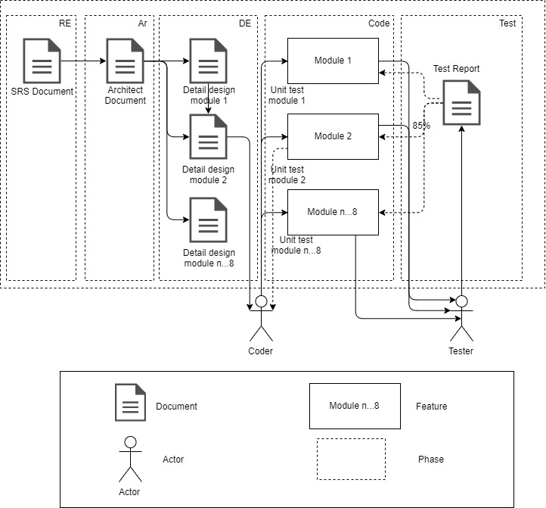
3. ARCHITECTURAL
Testability (Overview)

Slide 27
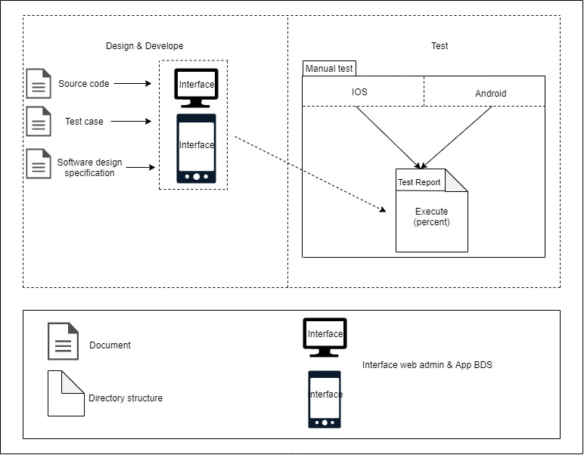
3. ARCHITECTURAL
Testability (test report)

Slide 28
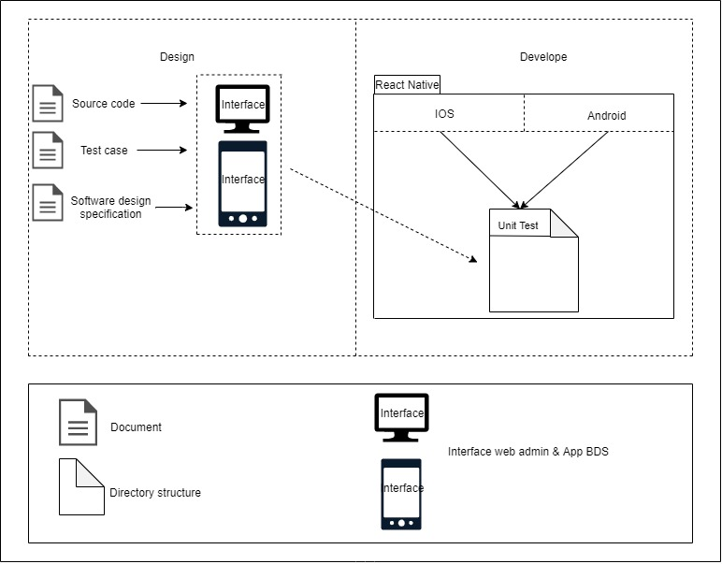
3. ARCHITECTURAL
Testability (unit test)

Slide 29
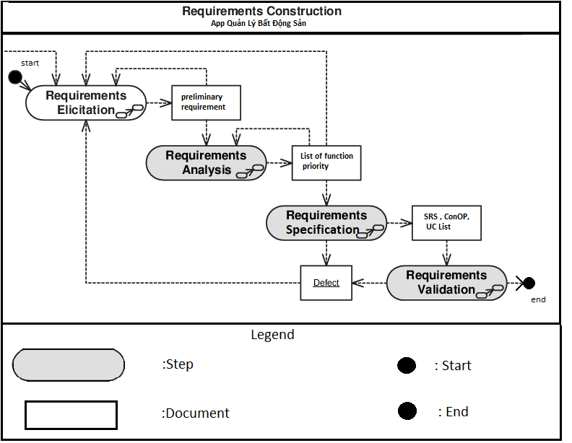
4. REQUIREMENT
Requirement Management Process

Slide 30
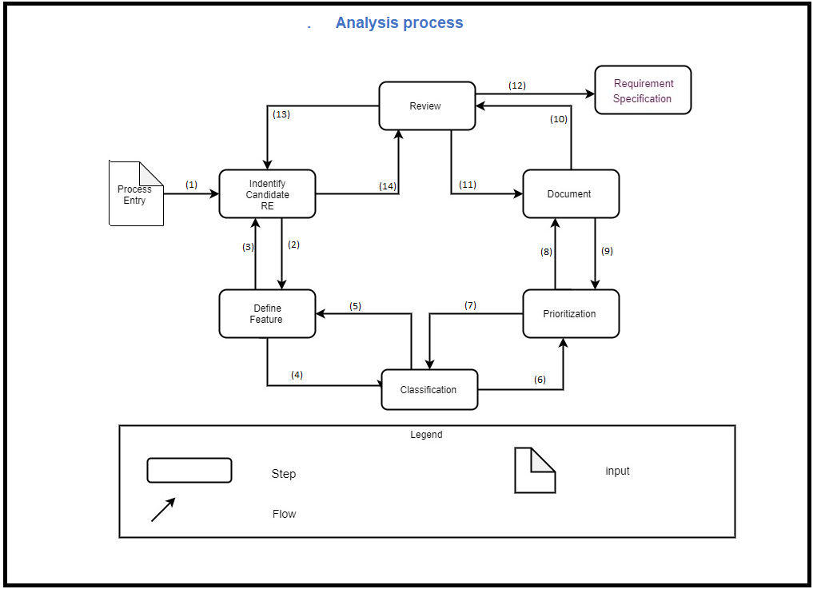
4. REQUIREMENT
Analysis process

Slide 31
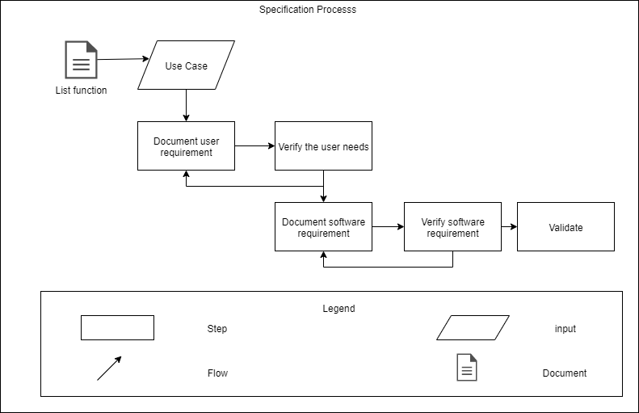
4. REQUIREMENT
Specification process

Slide 32
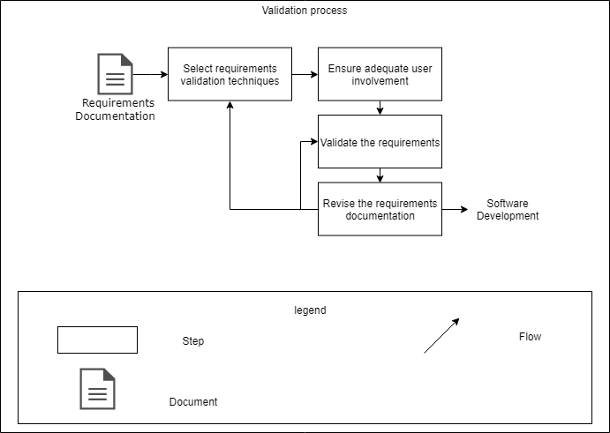
4. REQUIREMENT
Validation process

Slide 33
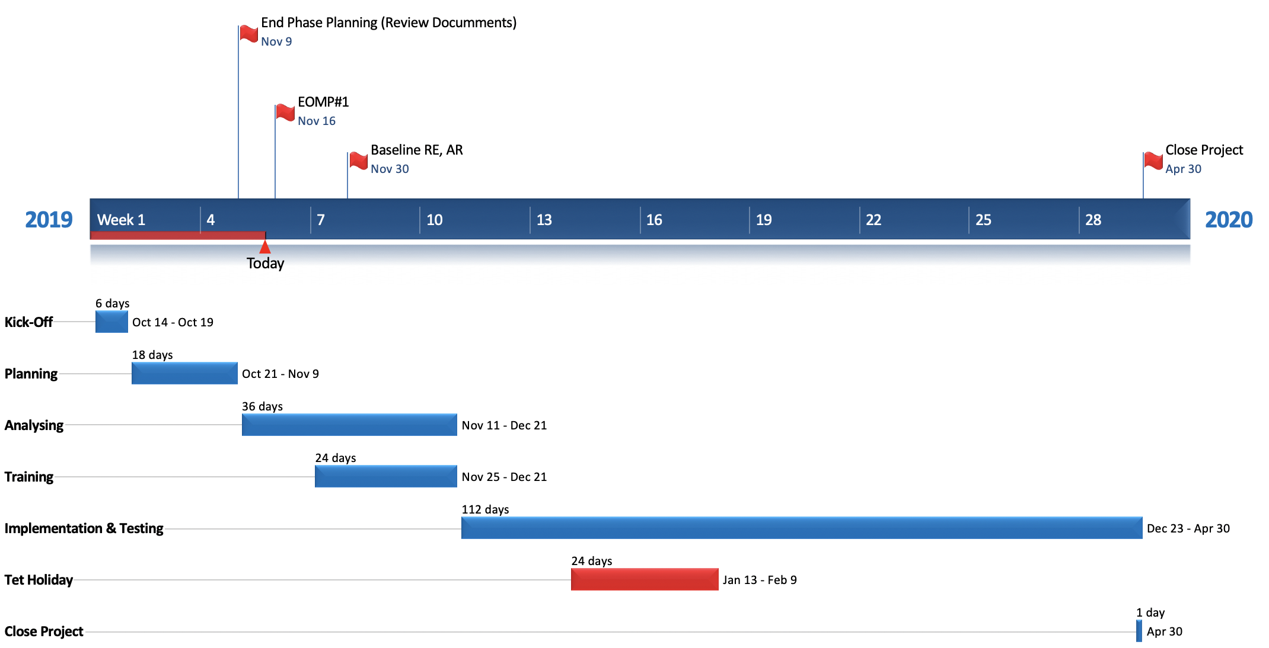
5. MONITORING & CONTROL
Project Timeline & Milestones

Slide 34
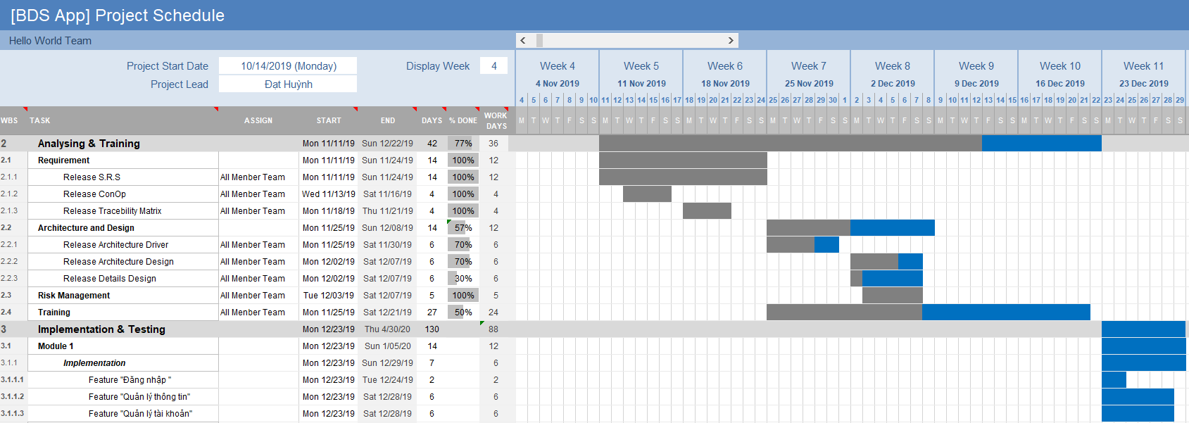
5. MONITORING & CONTROL
Project Schedule

Slide 35
THANK YOU

